Slide 1
CardioClassifier: Real-Time Murmur Detection Using Machine Learning
Lakshmanan Rajaram
Department of ECE
Colorado State University
lakshmanan.rajaram@colostate.edu
CSU ID:C837382757

Slide 2
Introduction
Focuses on detecting heart murmurs from heart sound audio data.
Critical for early diagnosis of conditions like valve insufficiencies and heart muscle abnormalities.
Employs a dual-model architecture combining CNNs and RNNs with LSTMs.
Captures both spatial and sequential features of audio data.
Incorporates real-time analysis and edge computing with Jetson Nano.
Aims to enhance robustness and accessibility in clinical and remote settings.

Slide 3
Data Collection and Preprocessing
Utilized publicly available datasets like PhysioNet/CinC Challenge 2016 and curated additional heart sound recordings.
Applied preprocessing techniques including:
Noise reduction and filtering to improve audio quality.
Segmentation of heart sound cycles (S1, S2) for better feature extraction.
Mel-frequency cepstral coefficients (MFCCs) and spectrogram generation for feature representation.

Slide 4
Model Architecture
Designed a dual-model approach combining:
Convolutional Neural Networks (CNNs): For spatial feature extraction from spectrograms.
Recurrent Neural Networks (RNNs) with Long Short-Term Memory (LSTM): For capturing sequential patterns in the audio data.
Implemented a custom loss function to balance precision and recall for better murmur detection.

Slide 5
Model Training and Evaluation
Split data into training, validation, and test sets to prevent overfitting.
Used data augmentation techniques (e.g., pitch and speed adjustments) to increase model robustness.
Evaluated the model using key metrics: accuracy, precision, recall, and F1-score.

Slide 6
Edge Computing Integration
Deployed the trained model on Jetson Nano to enable real-time heart sound analysis.
Optimized the model for low-power environments without compromising performance.

Slide 7
Enhancements for Robustness
Introduced adaptive noise filtering to handle varying recording conditions.
Improved generalization by training the model on diverse datasets.

Slide 8
Deployment and Testing
Conducted testing in simulated and real-world conditions to validate performance.
Incorporated user feedback for further refinement of the system.

Slide 9
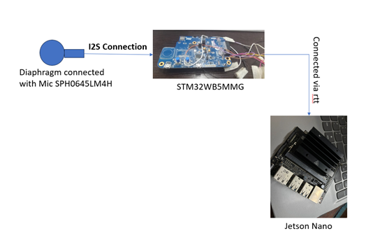
IMPLEMENTATION DETAILS

Slide 10
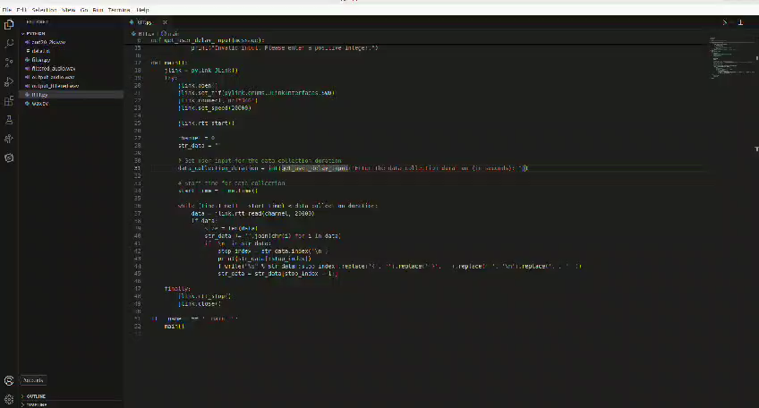
Data from STM

Slide 11
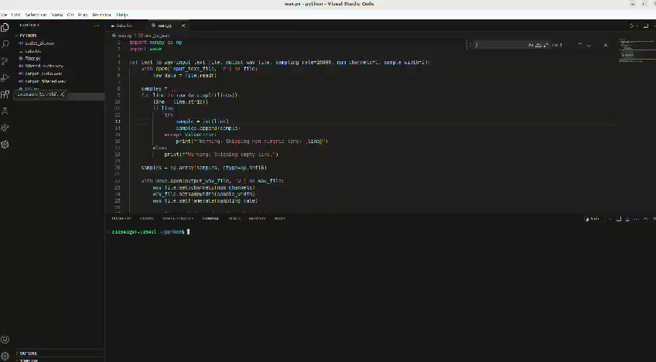
Audio Conversion

Slide 12
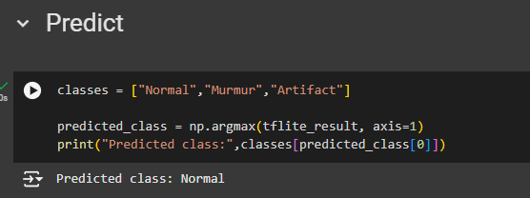
Prediction In Jetson
Another Script in python is used to find the murmurs. The model is build and and that specific model is used for prediction.
Result will be like

Slide 13
MERITS
Enhanced Accuracy
Dual-Model Architecture
Real-Time Analysis
Edge Computing Integration
Robustness to Noise
Scalability
Cost-Effective

Slide 14
Applications of the System
Clinical Diagnositics
Remote healthcare
Portable Medical Device

Slide 15
Conclusion
The CardioClassifier project, aimed at detecting heart murmurs using a machine learning approach that integrates convolutional neural networks (CNNs) and recurrent neural networks (LSTMs), has demonstrated promising results in its initial testing phases. Through the use of advanced neural network architectures and the application of edge computing on platforms like the Jetson Nano, we have created a system that not only achieves a robust detection capability but also operates efficiently in real-time environments.

Slide 16
Thank you

